Slide 1

#LifeKoKaroLift
Data Science Certification Program

Slide 2


Course : Data Science
Lecture On : Numpy
Instructor : Shivani Kapania

Slide 3
In Last Class, we covered….
1
Sorting basics
2
Data Types
3
Counter objects
4
Classes in Python

Slide 4
Today’s Agenda
Create Numpy arrays
Convert lists and tuples to NumPy arrays
Create (initialise) arrays
Inspect the structure and content of arrays
Understand advantages of using vectorized code using Numpy

Slide 5
Numpy: An overview
Numpy is a library written for scientific computing and data analysis.
The basic object in NumPy is the ndarray, or simply an array, which is an n-dimensional, homogenous array.

Slide 6
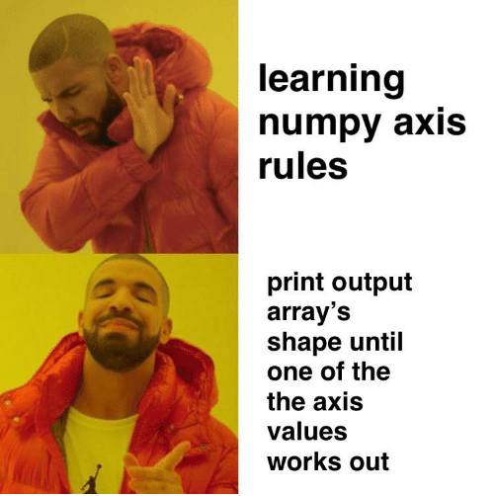
Numpy: An overview
In NumPy, dimensions are called axes.
In NumPy terminology, for 2-D arrays:
axis = 0 refers to the rows
axis = 1 refers to the columns

Slide 7
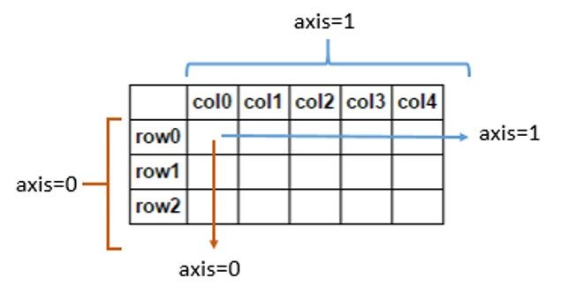
Dimensions in Numpy array

Slide 8
Creating Numpy arrays
np.array()
Numpy array from list
Numpy array from tuple
Initialize array of fixed size
np.ones()
np.zeros()
np.random.random()
np.arange()
np.linspace()

Slide 9
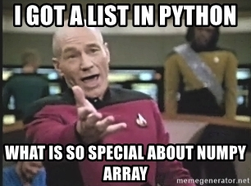
WHY NUMPY?
Numpy
Vectorization
Broadcasting
Indexing

Slide 10
WHY NUMPY?
Vectorization
Practice of replacing explicit loops with array expressions.
Broadcasting
For arrays with different shapes.
Indexing
Basic indexing
Advanced indexing
Express operations as occurring on entire arrays rather than their individual elements.
The smaller array is “broadcast” across the larger array so that they have compatible shapes.

Slide 11
#LifeKoKaroLift
Thank You!

